Slide 1

Geography
N 3-4
Year
4
Curriculum Map and Assessment
Framework
Year
1
Year
5
Key Stage 3

Slide 2
EYFS – Understanding the World
N 3-4
Year
4
Development Matters
Nursery
Development Matters Reception
ELG
Use all their senses in hands-on exploration of natural materials.
Explore collections of materials with similar and/or different properties.
Talk about what they see, using a wide vocabulary.
Begin to make sense of their own life-story and family’s history.
Show interest in different occupations. Explore how things work.
Plant seeds and care for growing plants. Understand the key features of the life cycle of a plant and an animal.
Begin to understand the need to respect and care for the natural environment and all living things.
Explore and talk about different forces they can feel.
Talk about the differences between materials and changes they notice.
Continue developing positive attitudes about the differences between people.
Know that there are different countries in the world and talk about the differences they have experienced or seen in photos..
Talk about members of their immediate family and community.
Name and describe people who are familiar to them.
Comment on images of familiar situations in the past.
Compare and contrast characters from stories, including figures from the past.
Draw information from a simple map.
Understand that some places are special to members of their community.
Recognise that people have different beliefs and celebrate special times in different ways.
Recognise some similarities and differences between life in this country and life in other countries.
Explore the natural world around them.
Describe what they see, hear and feel whilst outside.
Recognise some environments that are different to the one in which they live. • Understand the effect of changing seasons on the natural world around them.
Children at the expected level of development will:-
Describe their immediate environment using knowledge from observation, discussion, stories, non-fiction texts and maps
Explain some similarities and differences between life in this country and life in other countries, drawing on knowledge from stories, non-fiction texts and (when appropriate) maps.
Know some similarities and differences between the natural world around them and contrasting environments, drawing on their experiences and what has been read in class.
Year
1
Year
5
Key Stage 3

Slide 3
EYFS – Milestones for Continuous Provision
Children in Nursery will:
Children in Reception will:
N 3-4
Year 1 Ready:
Year
4
• Tell you something about where they live e.g. the number of their house, the street where
they live, something that is near their house.
• Talks about features of their immediate environment.
• Talk about how different environments are different when looking at photographs and
books.
• Show an interest in looking at maps and globes.
Talk about their own immediate environment and how environments in other parts of the world differ e.g. are hotter or colder.
• Use geographical words e.g. forest, beach, mountain when looking at physical features of
different landscapes.
• Understand that a map is a drawing from above.
• Draw imaginary maps as part of their play.
• Find features of their environment on a simple map or oblique aerial photograph.
Talk about and compare their immediate environment and different environments they
have been taught about, using some accurate geographical vocabulary.
I can
Say where I live
Talk about the special places in our community
Say how the places are the same and different
Talk about my environment at home and school
Talk about places I have visited
Talk about natural and built environments and listen to different points of view
which they live
Year
1
Year
5
Understanding The World – People, Culture and Communities
Key Stage 3

Slide 4
EYFS – Milestones for Continuous Provision
N 3-4
Year
4
Children in Nursery will:
Children in Reception will:
Year 1 Ready:
• Use their senses in hands on exploration.
• Sort clothing to wear in different climates/ types of weather.
• Dress appropriately to go outside in wet, cold and windy weather.
• Identify that certain animals live in different environments.
• Identify some key signs of each season.
• Sequences and talk about the
• Describe some the effects of changing seasons on the natural world.
• Begin to understand what they can do to help the environment.
Explore, make observations, and ask questions about the natural world, gaining a
developing understanding of important processes and changes they observe.
I can
Say how I know the seasons have changed
Name the four seasons of the year.
Name and locate hot and cold locations around the world
Year
1
Year
5
Understanding The World – The Natural World
Key Stage 3

Slide 5
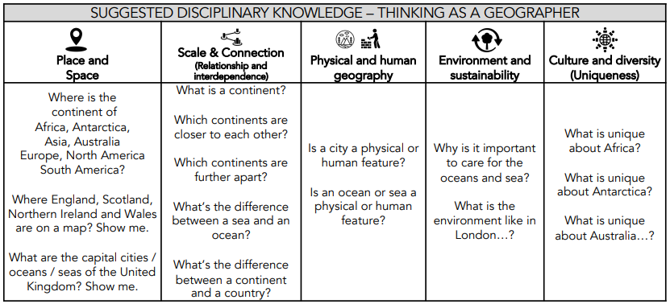
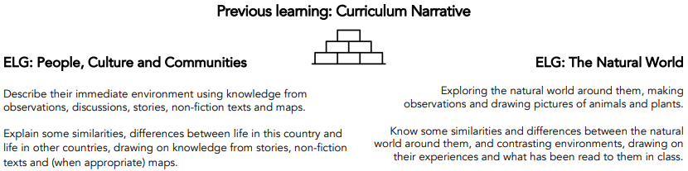

Key Stage 1 – Year 1
Term | NC objectives | The Big Idea Substantive Concepts | How will I think and act like a Geographer | Pupil Outcomes/End Point Knowledge
Year 1 Autumn Term Continent, oceans, countries, capital cities and seas | Locational knowledge: Name and locate the world’s seven continents and five oceans. - Name, locate and identify characteristics of the four countries and capital cities of the United Kingdom and its surrounding seas. | How is our world organised? How is the United Kingdom organised? LOCATION Where is a place found |  | Pupils should know that: There are seven continents in the world: Asia, Africa, Antarctica, Australia, Europe, North America and South America. There are five oceans in the world: Atlantic Ocean, Arctic Ocean, Indian Ocean, Pacific Ocean (the biggest) and the Southern Ocean. There are four countries in the United Kingdom: England, Northern Ireland, Scotland and Wales. The capital city of England is London. The capital city of Northern Ireland is Belfast. The capital city of Scotland is Edinburgh. The capital city of Wales is Cardiff. The United Kingdom is surrounded by the North Sea, the Irish Sea, the English Channel and the Atlantic Ocean.
Curriculum Narrative and Previous Learning
N 3-4
Year
4
Year
1
Year
5
Key Stage 3

Slide 6
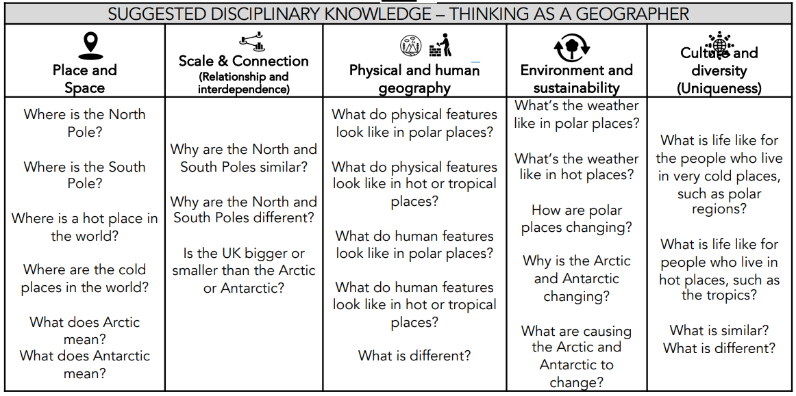
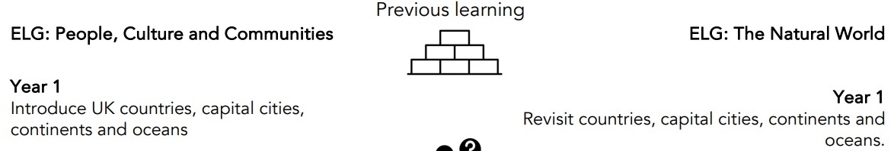
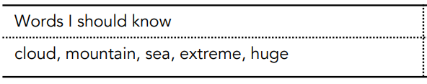
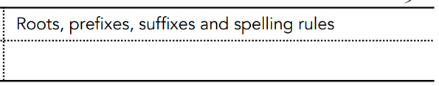
Key Stage 1 – Year 1
Term | NC objectives | The Big Idea Substantive Concepts | How will I think and act like a Geographer | Pupil Outcomes/End Point Knowledge
Year 1 Spring Term Hot and cold locations | Human and physical geography - identify seasonal and daily weather patterns in the United Kingdom and the location of hot and cold areas of the world in relation to the Equator and the North and South Poles | Location, Environment Culture Physical and human geography Hot and cold locations in the world |  | Pupils should: know and explain seasonal and daily weather patterns • locate the Equator, North and South Poles • locate and name hot and cold places in the world • use geographical vocabulary to refer to physical features:: o beach, cliff, coast, forest, hill, landmark, mountain, ocean, river, sea, soil, savanna, valley, vegetation, season, weather, urban, rural and coastal • use geographical vocabulary to refer to human features: o city, town, village, landmark, factory, farm, house, office, port, harbour, shop, slum
Curriculum Narrative and Previous Learning
N 3-4
Year
4
Year
1
Year
5
Key Stage 3

Slide 7
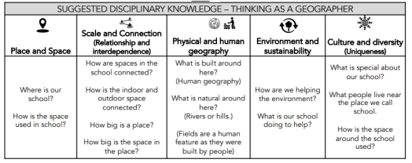
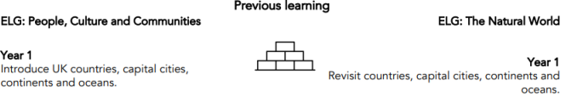

Key Stage 1 – Year 1
Term | NC objectives | The Big Idea Substantive Concepts | How will I think and act like a Geographer | Pupil Outcomes/End Point Knowledge
Year 1 Summer Term Fieldwork and mapping | Human and physical geography: - Use simple fieldwork and observational skills to study the geography of their school and its grounds and the key human and physical features of its surrounding environment. | GEOGRAPHICAL SKILLS - The use of maps, atlases and globes to know and explain more about location and a place. Identifying physical and human features to explain what places are like. FIELDWORK - Collecting and using information to know more and explain what a location or place is like. |  | Pupils should know that: - A map shows a place in a particular area. - Maps tell us what a place is like (e.g. is it a city, town or village). - Maps tell us how the space is used e.g. homes, schools etc.
Curriculum Narrative and Previous Learning
N 3-4
Year
4
Year
1
Year
5
Key Stage 3

Slide 8
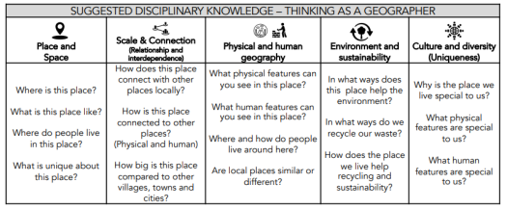
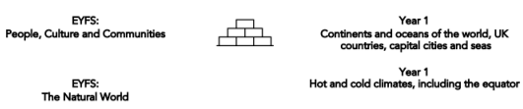

Key Stage 1 – Year 2
Term | NC objectives | The Big Idea Substantive Concepts | How will I think and act like a Geographer | Pupil Outcomes/End Point Knowledge
Year 2 Autumn Term Local Area Study Human and Physical Features | Human and physical geography: - use world maps, atlases and globes to identify the United Kingdom and its countries, as well as the countries, continents and oceans studied at this key stage - use simple compass directions (North, South, East and West) and locational and directional language [for example, near and far; left and right], to describe the location of features and routes on a map - use aerial photographs and plan perspectives to recognise landmarks and basic human and physical features; devise a simple map; and use and construct basic symbols in a key - use simple fieldwork and observational skills to study the geography of their school and its grounds and the key human and physical features of its surrounding environment. | HUMAN FEATURES – The built environment that was made by humans. PHYSICAL FEATURES – The natural environment and shaped by nature. |  | Pupils should know that: - A human feature is something built or put there by a person. - Factories, houses and play parks are examples of human features. - Ports are where boats unload cargo and passengers. - Harbours are where ships shelter from rough seas. - Physical features are natural and shaped by nature. - Forests, rivers, seas and valleys are examples of physical features. - Oceans are much larger than seas. - A rural area is a village or town in the countryside. - An urban area is a town or city. - A coastal area is a village, town or city near or by the sea.
Curriculum Narrative and Previous Learning
N 3-4
Year
4
Year
1
Year
5
Key Stage 3

Slide 9
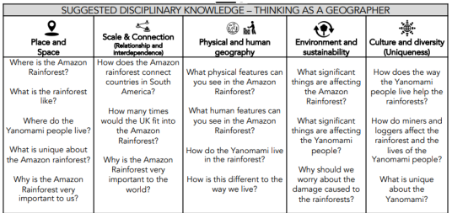


Key Stage 1 – Year 2
Term | NC objectives | The Big Idea Substantive Concepts | How will I think and act like a Geographer | Pupil Outcomes/End Point Knowledge
Year 2 Spring Term Study a small area of a contrasting non European country (Yanomami people of the rainforest) | Understand geographical similarities and differences through studying the human and physical geography of a small area of the United Kingdom, and of a small area in a contrasting non European country | PLACE – The study of what a location is like by looking and the human and physical features. |  | Pupils should know that: - Areas on the equator are hot and humid. - Rainforests are the world’s oldest living ecosystems. - The Amazon rainforest is full of life such as jaguars, spider monkeys and pink river dolphins. - The Yanomami tribe live in remote rainforests in northern Brazil and southern Venezuela in South America. - They live in the Amazon rainforest. - The Yanomami tribe have not advanced past the Stone Age (they have not discovered how to use metal) - Yanomami houses are circular and called ‘yanos’. These are thatched with vine and leaves. - Their villages are semi-permanent as they move around (nomadic people). - The Yanomami are hunter-gatherers that collect plants (maize, plantain, seeds etc) and hunt monkeys, deer and fish. - Their transport is on foot and by canoe. - They believe all living and on-living things have a spirit. - The Yanomami are threatened by gold miners, deforestation and disease.
Curriculum Narrative and Previous Learning
N 3-4
Year
4
Year
1
Year
5
Key Stage 3

Slide 10
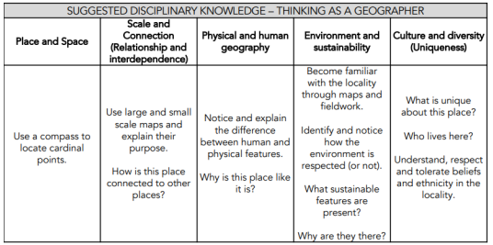
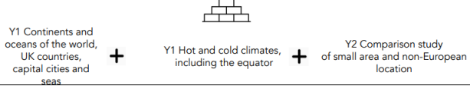

Key Stage 1 – Year 2
Term | NC objectives | The Big Idea Substantive Concepts | How will I think and act like a Geographer | Pupil Outcomes/End Point Knowledge
Year 2 Spring Term Fieldwork and Map skills | Fieldwork and map skills: - use simple compass directions (North, South, East and West) and locational and directional language [for example, near and far; left and right], to describe the location of features and routes on a map. - use aerial photographs and plan perspectives to recognise landmarks and basic human and physical features; devise a simple map; and use and construct basic symbols in a key. - use simple fieldwork and observational skills to study the geography of their school and its grounds and the key human and physical features of its surrounding environment. | GEOGRAPHICAL SKILLS - The use of maps, atlases and globes to know and explain more about location and a place. Identifying physical and human features to explain what places are like. FIELDWORK - Collecting and using information to know more and explain what a location or place is like. |  | Pupils should know that: - There are four cardinal points on a compass: North, East, South and West. - An aerial view is an image of a place from above, much like a photograph. Sometimes it can be called a birdseye view. - A map is a representation of a place from above. - Physical features are natural features, such as valleys, lakes and rivers. = Human features are built by people, such as houses, train stations and bridges. - A key shows symbols and helps a map reader to understand them on a map. - Maps must have a title and a key. - Sketch maps must have a title, key, North compass direction and other cardinal points of the compass. - A map’s scale is the difference between your map and the distance on the ground. - Large-scale maps make places appear larger, useful for looking at houses and roads. - Small-scale maps make places appear smaller, useful for looking at the wider area.
Curriculum Narrative and Previous Learning
N 3-4
Year
4
Year
1
Year
5
Key Stage 3

Slide 11
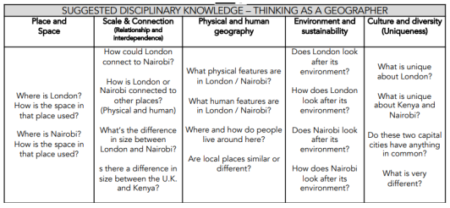
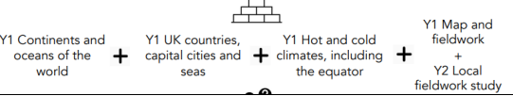

Key Stage 1 – Year 2
Term | NC objectives | The Big Idea Substantive Concepts | How will I think and act like a Geographer | Pupil Outcomes/End Point Knowledge
Year 2 Summer Term Compare a small part of the UK and a contrasting non European country | Place knowledge: Understand geographical similarities and differences through studying the human and physical geography of a small area of the United Kingdom, and of a small area in a contrasting non European country | PLACE The study of what a location is like by looking and the human and physical features. |  | Pupils should know that: - The capital city of England is London. - The United Kingdom is in the continent of Europe. - The Tower of London and the London Eye are London landmarks. - The capital city of Kenya is Nairobi. - Kenya is a country in the continent of Africa and can be found on the Equator. - Kenya has a coastline and is 2 ½ times bigger than the UK. - Some of Kenya’s notable physical features include Mount Kenya, savannahs and Lake Victoria. - A savannah has dry grassland, is flat and spreads over a vast area and has few trees. - The Maasai tribe are the native people of Kenya who are proud and courageous warriors. They herd cattle and goats. - The colours of the Kenyan flag have significance (black – the people, blood – blood, green – wealth and white – peace) - Nairobi has a national park, is a bustling city, is an urban area and has fascinating wildlife. - Nairobi has slums, where more than half of the people in Nairobi live in poverty. - Like London’s Big Ben, Nairobi has a Parliament Clock Tower. - Both London and Nairobi are urban places and busy cities. - Nairobi has slums and savannahs unlike London. - The climate in London and Nairobi is different due to their locations. - London and Nairobi both have rivers, landmarks and are urban places.
Curriculum Narrative and Previous Learning
N 3-4
Year
4
Year
1
Year
5
Key Stage 3

Slide 12
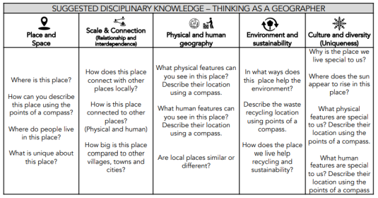

Key Stage 2 – Year 3
Term | NC objectives | The Big Idea Substantive Concepts | How will I think and act like a Geographer | Pupil Outcomes/End Point Knowledge
Year 3 Autumn Term Fieldwork and Map skills | Human and physical geography - describe and understand key aspects of: - physical geography, including: climate zones, biomes and vegetation belts, rivers, mountains, volcanoes and earthquakes, and the water cycle - human geography, including: types of settlement and land use, economic activity including trade links, and the distribution of natural resources including energy, food, minerals and water Geographical skills and fieldwork: - use maps, atlases, globes and digital/computer mapping to locate countries and describe features studied - use the eight points of a compass (including the use of Ordnance Survey maps) to build their knowledge of the United Kingdom and the wider world - use fieldwork to observe, measure, record and present the human and physical features in the local area using a range of methods, including sketch maps, plans and graphs, and digital technologies | LOCATION PLACE HUMAN FEATURES PHYSICAL FEATURES GEOGRAPHICAL SKILLS FIELDWORK |  | Pupils should know that: - There are four cardinal points on a compass: North, East, South and West. - Cardinal points are the essential compass points. - Intercardinal points are points in between the cardinal points: North East, South East, South West and North West. - Intercardinal means between essential. - Physical features are natural features such as fields and rivers. - Human features are man-made features such as cities and bridges. - A settlement in a location where many people live. - Trade means the marking, selling and buying of goods, or doing jobs to make money. - Recreation is when people relax or take part in sport. - Travel describes the movement or people and goods.
Curriculum Narrative and Previous Learning
N 3-4
Year
4
Year
1
Year
5
Key Stage 3

Slide 13
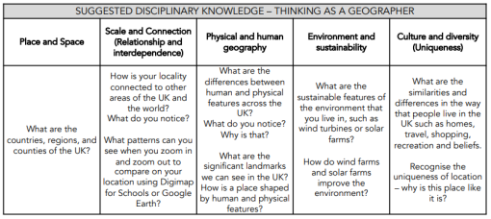
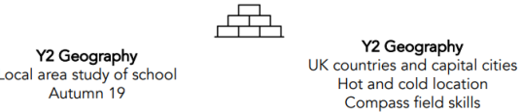

Key Stage 2 – Year 3
Term | NC objectives | The Big Idea Substantive Concepts | How will I think and act like a Geographer | Pupil Outcomes/End Point Knowledge
Year 3 Spring Term United Kingdom Study | UK study: - name and locate counties and cities of the United Kingdom - geographical regions and their identifying human and physical characteristics - key topographical features (including hills, mountains, coasts and rivers | LOCATION – where a place is found. HUMAN FEATURES – The built environment that was made by humans. PHYSICAL FEATURES – The natural environment and shaped by nature. |  | Pupils should know that: - The UK is short for United Kingdom of Great Britain and Northern Ireland. - The four countries of the United Kingdom are Northern Ireland, England, Scotland and Wales. . Edinburgh is the capital city of Scotland; London is the capital of England; Belfast is the capital of Northern Ireland and Cardiff is the capital of Wales. - A county is an area with a local government, such as Suffolk. - Human features are man-made; physical features are natural. - Leeds, Manchester and Liverpool are cities north of Leicester. - Cambridge, London and Bristol are cities south of Leicester. - Mountains and hills are mostly found in western and northern areas of the UK. - Landmarks can be both human and physical features. - Physical landmarks include Ben Nevis and the White cliffs of Dover. - Human landmarks include Hadrian’s Wall and Stonehenge. - Eastern England is mostly flat with few hills. - Mount Snowdon can be found in Wales. Ben Nevis can be found in Scotland. Scafell Pike can be found in England. - The River Bann is a major river in Northern Ireland. - Topography means to describe a place. - Maps have symbols to help us understand them. - Large scale maps are useful for showing buildings and roads’ small-scale maps are useful for viewing larger areas.
Curriculum Narrative and Previous Learning
N 3-4
Year
4
Year
1
Year
5
Key Stage 3

Slide 14
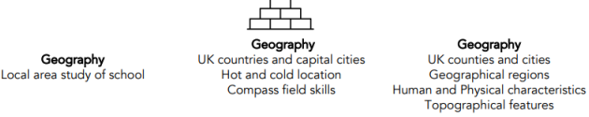
Key Stage 2 – Year 3
Term | NC objectives | The Big Idea Substantive Concepts | How will I think and act like a Geographer | Pupil Outcomes/End Point Knowledge
Year 3 Summer Term United Kingdom Study (REVISIT) | UK study: - name and locate counties and cities of the United Kingdom - geographical regions and their identifying human and physical characteristics - key topographical features (including hills, mountains, coasts and rivers | LOCATION – where a place is found. HUMAN FEATURES – The built environment that was made by humans. PHYSICAL FEATURES – The natural environment and shaped by nature. |  | Pupils should know that: - The UK is short for United Kingdom of Great Britain and Northern Ireland. - The four countries of the United Kingdom are Northern Ireland, England, Scotland and Wales. . Edinburgh is the capital city of Scotland; London is the capital of England; Belfast is the capital of Northern Ireland and Cardiff is the capital of Wales. - A region is a large area. - A county is an area with a local government, such as Suffolk. - Human features are man-made; physical features are natural. - Leeds, Manchester and Liverpool are cities north of Leicester. - Cambridge, London and Bristol are cities south of Leicester. - Mountains and hills are mostly found in western and northern areas of the UK. - Landmarks can be both human and physical features. - Physical landmarks include Ben Nevis and the White cliffs of Dover. - Human landmarks include Hadrian’s Wall and Stonehenge. - Eastern England is mostly flat with few hills. - Mount Snowdon can be found in Wales. Ben Nevis can be found in Scotland. Scafell Pike can be found in England. Slieve Donard can be found in Northern Ireland. - The River Bann is a major river in Northern Ireland.
Curriculum Narrative and Previous Learning
N 3-4
Year
4
Year
1
Year
5
Key Stage 3

Slide 15
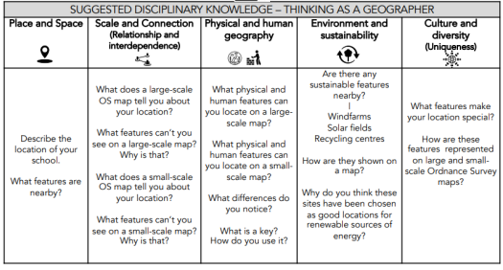

Key Stage 2 – Year 3
Term | NC objectives | The Big Idea Substantive Concepts | How will I think and act like a Geographer | Pupil Outcomes/End Point Knowledge
Year 3 Summer Term OS Map Skills and Fieldwork | Map Skills and Fieldwork: - use maps, atlases, globes and digital/computer mapping to locate countries and describe features studied - use the eight points of a compass, four and six-figure grid references, symbols and key (including the use of Ordnance Survey maps) to build their knowledge of the United Kingdom and the wider world - use fieldwork to observe, measure, record and present the human and physical features in the local area using a range of methods, including sketch maps, plans and graphs, and digital technologies. | LOCATION – where a place is found. HUMAN FEATURES – The built environment that was made by humans. PHYSICAL FEATURES – The natural environment and shaped by nature. |  | Pupils should know that: - OS stands for Ordnance Survey. - OS maps were first drawn up in 1833 - Ordnance means cannons/gunners and survey means to look upon/notice. - Scale is the distance between your map and the distance on the ground. - Large-scale maps show the wider areas; small-scale maps show more detail. - A key unlocks the map’s meaning using symbols to help us read a map.
Curriculum Narrative and Previous Learning
N 3-4
Year
4
Year
1
Year
5
Key Stage 3

Slide 16
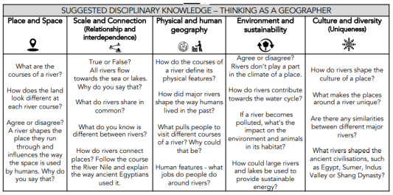
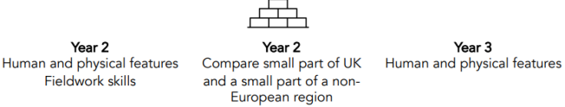


Key Stage 2 – Year 4
Term | NC objectives | The Big Idea Substantive Concepts | How will I think and act like a Geographer | Pupil Outcomes/End Point Knowledge
Year 4 Autumn Term Rivers | Human and physical geography - describe and understand key aspects of: - physical geography, including: climate zones, biomes and vegetation belts, rivers, mountains, volcanoes and earthquakes, and the water cycle - human geography, including: types of settlement and land use, economic activity including trade links, and the distribution of natural resources including energy, food, minerals and water | LOCATION – where a place is found. HUMAN FEATURES – The built environment that was made by humans. PHYSICAL FEATURES – The natural environment and shaped by nature. |  | Pupils should know that: - There are three courses in a river: upper, middle and lower. - The upper course is where the river begins – this is called the source; it also has fast-flowing water, vshaped valleys and rapids and waterfalls. - The middle course sees the river widen; the land flattens and meanders are found here. - The lower course is the end – this is called the mouth; you can find a wide, open river channel, slower water and floodplains here. - A tributary is a river that flows into a larger river. - Erosion describes how water shapes land over time; deposition describes how sediment in water is left behind. - Rivers flow through v-shaped valleys between mountains - The mouth of a river is where the river ends. - Floodplains are areas around a river that are flooded. - Confluence is the meeting of two rivers. - Oxbow lakes are formed when fast-flowing water on the outside of the river channel erodes the river bank, forming a new river channel. Sediment in slower moving waters cuts off the meander from the flow of the river. - The riverbed of the upper course contains mostly pebbles and rocks; the middle course mostly sand and mud’ the lower course mostly mud. - The River Lagan runs through Belfast; the River Taff through Cardiff; the River Thames through London; the Water of Leith runs through Edinburgh.
Curriculum Narrative and Previous Learning
N 3-4
Year
4
Year
1
Year
5
Key Stage 3

Slide 17
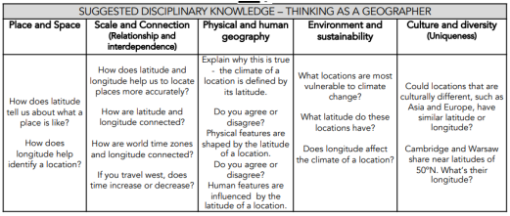
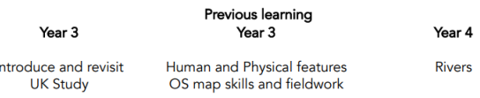
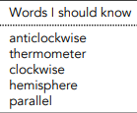
Key Stage 2 – Year 4
Term | NC objectives | The Big Idea Substantive Concepts | How will I think and act like a Geographer | Pupil Outcomes/End Point Knowledge
Year 4 Autumn Term Longitude and Latitude | Locational knowledge: - identify the position and significance of latitude, longitude, Equator, Northern Hemisphere, Southern Hemisphere, the Tropics of Cancer and Capricorn, Arctic and Antarctic Circle, the Prime/Greenwich Meridian and time zones (including day and night) | LOCATION – where a place is found. |  | Pupils should know that: - Latitude measures location north and south of the Equator. - The Equator can be found at 0°latitude. - The Earth can be divided into two halves – the northern hemisphere and the southern hemisphere. - There are 5 major lines of latitude: the Arctic Circle, the Tropic of Cancer, the Equator (0°), the Tropic of Capricorn and the Antarctic Circle - Areas within the Arctic and Antarctic Circle are extremely cold. - The Tropics have a hot and wet climate. - Longitude measures location east and west of the prime meridian - The prime meridian runs from the North Pole to the South Pole, through Greenwich, London which is the basis for all of the world’s time zones. - Greenwich Mean Time is known as GMT and is the name of the solar time on the longitude 0°. - We can use latitude to identify the climate of a location - There are several basic climate regions: polar, temperate or moderate, tropical, desert. - Countries to the east of the prime meridian are in front of UK time; countries to the left are behind UK time. - Earth rotates once every 24 hours in an anti-clockwise direction as it orbits the sun. This determines day and night on Earth. - Latitude is read before longitude.
Curriculum Narrative and Previous Learning
N 3-4
Year
4
Year
1
Year
5
Key Stage 3

Slide 18
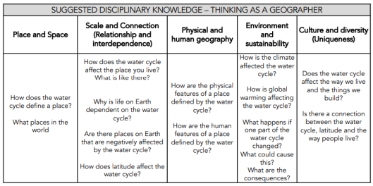


Key Stage 2 – Year 4
Term | NC objectives | The Big Idea Substantive Concepts | How will I think and act like a Geographer | Pupil Outcomes/End Point Knowledge
Year 4 Spring Term The Water Cycle | Human and physical geography – describe and understand key aspects of: - physical geography, including the water cycle. | HUMAN FEATURES – The built environment that was made by humans. PHYSICAL FEATURES – The natural environment and shaped by nature. |  | Pupils should know that: - Cycle means a series of repeat events. - The water cycle is powered by the sun. Heat from the sun’s direct rays heats the water which evaporates. This rises and cools down, condensing to form clouds. The clouds produce precipitation which soaks into the ground (percolation). Ground water then moves into lakes/rivers, restarting the cycles. - Evaporation means water being heated up until it becomes water vapour. - Condensation means water moisture cools and becomes denser to form clouds. - Precipitation means water falls from the clouds in the form of hail, sleet, rain or snow. - Percolation means water seeps into the ground and soil saturates rocks and soils. - Surface runoff means water collects in rivers/ lakes and runs back sea. - Groundwater means water makes its way underground to streams, rivers, lakes or the sea. - The water cycle is a continuous process. - Changes to the water cycle can lead to more floods and droughts. - Trees and plants reduce floods by taking up water through transpiration and their roots keep soil from washing away. -The water cycle can be impacted by deforestation, urbanisation and increased evaporation due to climate change. - Pollutants impact the water cycle as they can trap greenhouse gases, in turn increasing global temperatures. Sulphur dioxide can cause acid rain which weakens soils.
Curriculum Narrative and Previous Learning
N 3-4
Year
4
Year
1
Year
5
Key Stage 3

Slide 19
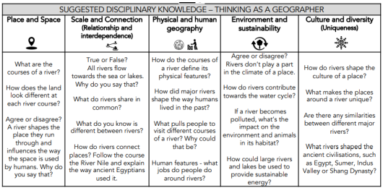

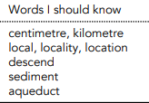
Key Stage 2 – Year 4
Term | NC objectives | The Big Idea Substantive Concepts | How will I think and act like a Geographer | Pupil Outcomes/End Point Knowledge
Year 4 Spring Term Rivers (REVISIT) | Human and physical geography - describe and understand key aspects of: - physical geography, including: climate zones, biomes and vegetation belts, rivers, mountains, volcanoes and earthquakes, and the water cycle - human geography, including: types of settlement and land use, economic activity including trade links, and the distribution of natural resources including energy, food, minerals and water | HUMAN FEATURES – The built environment that was made by humans. PHYSICAL FEATURES – The natural environment and shaped by nature. |  | Pupils should know that: - There are three courses in a river: upper, middle and lower. - The upper course is where the river begins – this is called the source; it also has fast-flowing water, vshaped valleys and rapids and waterfalls. - The middle course sees the river widen; the land flattens and meanders are found here. - The lower course is where the river ends – this is called the mouth; you can find a wide, open river channel, slower water and floodplains here. - A meander is a bend in the river. - All rivers flow into a sea or a lake. - A tributary is a river or stream that flows into a larger river. - Erosion describes how water shapes land over time; deposition describes how sediment in water is left behind. - Rivers flow through v-shaped valleys between hills and mountains. - The mouth of a river is where the river ends. - Floodplains are areas around a river that are flooded. - Confluence is the meeting of two rivers. - Oxbow lakes are formed when fast-flowing water on the outside of the river channel erodes the river bank, forming a new river channel. Sediment in slower moving waters cuts off the meander from the flow of the river. - The riverbed of the upper course contains mostly pebbles and rocks; the middle course mostly sand and mud; the lower course mostly mud.
Curriculum Narrative and Previous Learning
N 3-4
Year
4
Year
1
Year
5
Key Stage 3

Slide 20
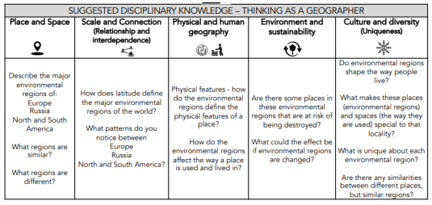

Key Stage 2 – Year 4
Term | NC objectives | The Big Idea Substantive Concepts | How will I think and act like a Geographer | Pupil Outcomes/End Point Knowledge
Year 4 Summer Term Study the environment al regions of Europe, Russia, North and South America. | Locational knowledge: - locate the world’s countries, using maps to focus on Europe (including the location of Russia) and North and South America, concentrating on their environmental regions, key physical and human characteristics, countries, and major cities | LOCATION – The place where something is found. GEOGRAPHICAL SKILLS - The use of maps, atlases and globes to know and explain more about location and a place. Identifying physical and human features to explain what places are like. FIELDWORK - Collecting and using information to know more and explain what a location or place is like. |  | Pupils should know that: - There are 6 environmental regions on Earth: temperate, Mediterranean, snow, polar, Equatorial and arid. - Temperate regions have warm or hot summers and colder winters. - Mediterranean regions have a hot and dry summer. The winter is cooler with some rainfall, but barely any frost. - Snow regions have long and cold winters, short summers and rapid changes in the spring and autumn. - Polar regions are very, very cold (up to -60 degrees Celsius in the Arctic). - Equatorial regions are tropical (warm and wet). These are found between the Tropic of Cancer and the Tropic of Capricorn. - Arid regions are deserts which are the hottest and driest regions with no or little rainfall. - Europe has temperate, Mediterranean, snow and polar regions. - Russia is the largest country in the world and spans two continents. It has snow, polar and temperate regions. - North America has all 6 environmental regions. - South America has temperate, Mediterranean, arid, polar and equatorial regions.
Curriculum Narrative and Previous Learning
N 3-4
Year
4
Year
1
Year
5
Key Stage 3

Slide 21
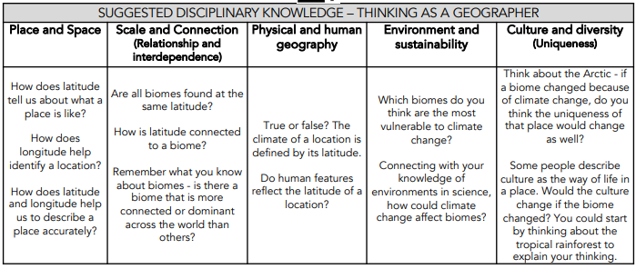



Key Stage 2 – Year 5
Term | NC objectives | The Big Idea Substantive Concepts | How will I think and act like a Geographer | Pupil Outcomes/End Point Knowledge
Year 5 Autumn Term Study the environment al regions of Europe, Russia, North and South America. | Locational knowledge: - locate the world’s countries, using maps to focus on Europe and North and South America, concentrating on their environmental regions, key physical and human characteristics, countries, and major cities | LOCATION – The place where something is found. PLACE – what a place is like and how it is connected to other places. HUMAN FEATURES – The built environment that was made by humans. PHYSICAL FEATURES – The natural environment and shaped by nature. |  | Pupils should know that: - There are seven continents: Europe, Asia, Australia, Antarctica, North America, South America and Africa. - The world is divide into the northern and southern hemisphere. - Latitude and longitude can be used to locate places around the world. - There are 44 countries in Europe; 23 countries in North and 12 in South America. - A city is a large urban settlement that is densely populated. - The two main languages in South America are Portuguese and Spanish. - Europe has a greater population than North America and it has the most spoken languages. - A biome is a region with a specific climate and where animals and plants are adapted to live there. - There are 8 major biomes: tundra, taiga, steppe, desert, mixed forest. Tropical, savannah and montane. - Tundra biomes are treeless and cold. - Taiga biomes are cold conifer forests. - Steppe biomes have dry grassland further away from the equator. - Desert biomes are large, dry and arid. This also include Antarctica. - Mixed forest biomes have evergreen and deciduous trees. - Tropical biomes have a hot and wet climate. - Savanna biomes have dry grassland, with a few trees nearer the equator. - Montane biomes are colder with mountains and trees. - The greatest mountain range in Europe is the Alps; in North America it is the Rock Mountains and in South America it is the Andes.
Curriculum Narrative and Previous Learning
N 3-4
Year
4
Year
1
Year
5
Key Stage 3

Slide 22
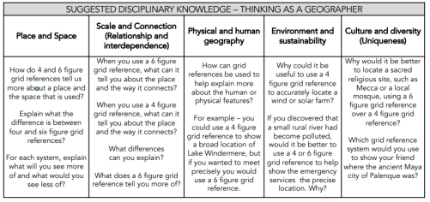


Key Stage 2 – Year 5
Term | NC objectives | The Big Idea Substantive Concepts | How will I think and act like a Geographer | Pupil Outcomes/End Point Knowledge
Year 5 Spring Term 4 and 6 Figure grid references | Locational knowledge - identify the position and significance of latitude, longitude, Equator, Northern Hemisphere, Southern Hemisphere, the Tropics of Cancer and Capricorn, Arctic and Antarctic Circle, the Prime/Greenwich Meridian and time zones (including day and night) Geographical skills and fieldwork - use maps, atlases, globes and digital/computer mapping to locate countries and describe features studied - use the eight points of a compass, four and six-figure grid references, symbols and key (including the use of Ordnance Survey maps) to build their knowledge of the United Kingdom and the wider world - use fieldwork to observe, measure, record and present the human and physical features in the local area using a range of methods, including sketch maps, plans and graphs, and digital technologies. | GEOGRAPHICAL SKILLS – The use of maps, atlases and globes to know and explain more about location and a place. Use 4 and 6 figure grid references with precision and accuracy. FIELDWORK – Collecting and using information to know more and explain what a location or place is like. Use 4 and 6 figure grid references to explain location and place. |  | Pupils should know that: - The Earth has two hemispheres@ north and south. - Latitude measures location north or south. - There are 90 lines of latitude in each hemisphere, each being 1 degree of latitude. - Latitude defines climate regions such as the Equator, Tropics, Arctic and Antarctic. - Longitude measures location east and west. There are 360 degrees of longitude called meridians. - We can find precise locations using the exact latitude and longitude. - 4 figure grid references give the location of a 1km x 1km square. They begin with a two letter reference, then have an Eastings number, followed by a Northings number. - 6 figure grid references give a more precise location within a 100m x 100m square. They begin with a two letter reference, followed by a 3-digit Eastings number and a 3-digit Northings number. - 4 figure grid references are useful for general locations e.g. woodlands; 6 figure grid references are useful for locating landmarks, buildings etc.
Curriculum Narrative and Previous Learning
N 3-4
Year
4
Year
1
Year
5
Key Stage 3

Slide 23
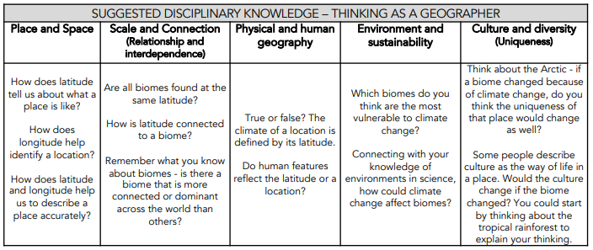

Key Stage 2 – Year 5
Term | NC objectives | The Big Idea Substantive Concepts | How will I think and act like a Geographer | Pupil Outcomes/End Point Knowledge
Year 5 Summer Term World Countries, Biomes and Vegetation Belts (REVISIT) | Locational knowledge: - locate the world’s countries, using maps to focus on Europe (including the location of Russia) and North and South America, concentrating on their environmental regions, key physical and human characteristics, countries, and major cities | LOCATION – The place where something is found. PLACE – what a place is like and how it is connected to other places. HUMAN FEATURES – The built environment that was made by humans. PHYSICAL FEATURES – The natural environment and shaped by nature. |  | Pupils should know that: - There are seven continents: Europe, Asia, Australia, Antarctica, North America, South America and Africa. - The world is divide into the northern and southern hemisphere. - Latitude and longitude can be used to locate places around the world. - There are 44 countries in Europe; 23 countries in North America and 12 in South America. - A city is a large urban settlement that is densely populated. - Washington DC is the capital of the USA; Moscow is the capital of Russia; Paris is the capital of France; Madrid is the capital of Spain; Buenos Aires is Argentina’s capital; Berlin is Germany’s. - The two main languages in South America are Portuguese and Spanish. - Europe has a greater population than North America and it has the most spoken languages. - A biome is a region with a specific climate and where animals and plants are adapted to live there. - There are 8 major biomes: tundra, taiga, steppe, desert, mixed forest. Tropical, savannah and montane. - Tundra biomes are treeless and cold. - Taiga biomes are cold conifer forests. - Steppe biomes have dry grassland further away from the equator. - Desert biomes are large, dry and sometimes arid. - Mixed forest biomes have evergreen and deciduous trees. - Tropical biomes have a hot and wet climate. - Savanna biomes have dry grassland - Montane biomes are colder with mountains and trees. - The greatest mountain range in Europe is the Alps; in North America it is the Rock Mountains and in South America, the Andes.
Curriculum Narrative and Previous Learning
N 3-4
Year
4
Year
1
Year
5
Key Stage 3

Slide 24
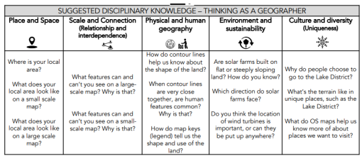


Key Stage 2 – Year 5
Term | NC objectives | The Big Idea Substantive Concepts | How will I think and act like a Geographer | Pupil Outcomes/End Point Knowledge
Year 5 Summer Term OS Maps and Fieldwork | - use maps, atlases, globes and digital/computer mapping to locate countries and describe features studied - use the eight points of a compass, four and six-figure grid references, symbols and key (including the use of Ordnance Survey maps) to build their knowledge of the United Kingdom and the wider world | GEOGRAPHICAL SKILLS – The use of maps, atlases and globes to know and explain more about location and a place. Use 4 and 6 figure grid references with precision and accuracy. FIELDWORK – Collecting and using information to know more and explain what a location or place is like. Use 4 and 6 figure grid references to explain location and place |  | Pupils should know that: - Ordnance Survey comes from ‘cannon or great gun’ and ‘look upon or notice’. - Small scale OS maps provide a wider view and are useful for locating cities, towns, motorways, mountains and hails. - Large scale OS maps provide a close-up view, useful for locating houses, buildings, river etc. - A scale of 1:25000, shows 1cm on the map as 250m on the ground. - 4 figure grid references give the location of a 1km x 1km square. They begin with a two letter reference, then have an Eastings number, followed by a Northings number. - 6 figure grid references give a more precise location within a 100m x 100m square. They begin with a two letter reference, followed by a 3-digit Eastings number and a 3-digit Northings number. - 4 figure grid references are useful for general locations e.g. woodlands; 6 figure grid references are useful for locating landmarks, buildings etc. - Contour lines help us understand the shape of the ground from a map. The close these lines are, the sleeper the slope is. - Contour lines show height above sea level, measured in metres. - Terrain is the shape of the land or ground. - Plateau comes from the Greek work platys, meaning flat, wide and broad.
Curriculum Narrative and Previous Learning
N 3-4
Year
4
Year
1
Year
5
Key Stage 3

Slide 25
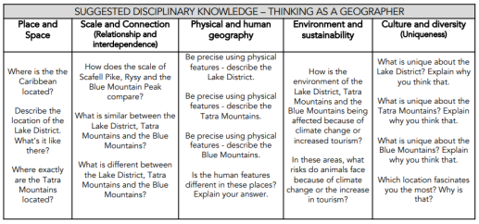


Key Stage 2 – Year 6
Term | NC objectives | The Big Idea Substantive Concepts | How will I think and act like a Geographer | Pupil Outcomes/End Point Knowledge
Year 6 Autumn Term OS Maps and Fieldwork | Place knowledge - understand geographical similarities and differences through the study of human and physical geography of a region of the United Kingdom, a region in a European country, and a region within North or South America | LOCATION – The locational position of a place in context to where it is found in the world, continent, country, region, country, city, town or village. PLACE – What a place is like and how it is connected to other places. |  | Pupils should know that: -The Lake District is a region located in North-West England in Cumbria, 54-55 degrees north. - It has England’s highest mountain, Scafell Pike, which stands at 978m. There is spectacular scenery which makes it popular to millions of tourists each year. Popular sites are Wast Water and Lake Windermere. - There is a large range of wildlife at the Lake District - Tourism helps towns and villages like Keswick and Ambleside prosper. - The Lake District is one of the wettest places in England, as moist clouds roll in from the Atlantic and condense over the mountains. - The Lake District was initially south of the Equator 500 million years ago. Mountains were formed 400 million years ago. These mountains were once as tall at the Himalayas but eroded down. - Poland is a European country, with a capital city named Warsaw. It is at a similar latitude to England. Its climate is temperate with cold and moderately severe winters. - The Tatra mountains are in southern Poland and form a border between Poland and Slovakia. They are a part of the Carpathian mountain range. They were formed 60 millions years ago and shaped by the Ice Age and glaciation. - Mount Rysy is the highest mountain in the Tatra mountains - Jamaica is a country within the Caribbean Islands in North America. It has a lot of tourism due to its sandy beaches, coral reefs and tropical climate. - Jamaica was formed by volcanic eruptions 75-100 million years ago. - It is found 18 degrees north of the Equator - Jamaica’s capital city is Kingston. - Blue Mountain Peak is the tallest mountain in Jamaica (2.256m). Its mist has a blue shade at a high altitude. World famous Blue Mountain coffee is grown here. - North Atlantic currents carry warm water to Europe and Britain.
Curriculum Narrative and Previous Learning
N 3-4
Year
4
Year
1
Year
5
Key Stage 3

Slide 26
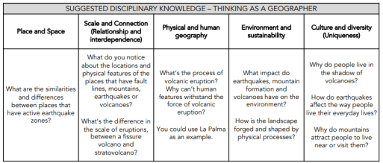
Key Stage 2 – Year 6
Term | NC objectives | The Big Idea Substantive Concepts | How will I think and act like a Geographer | Pupil Outcomes/End Point Knowledge
Year 6 Spring Term Physical processes – earthquake,mountains and volcanoes | Human and physical geography - Describe and understand key aspects of: - physical geography, including: mountains, volcanoes and earthquakes | HUMAN FEATURES – The built environment that was made by humans. PHYSICAL FEATURES – The natural environment and shaped by nature. |  | Pupils should know that: - The Earth is made of four layers: the crust, the mantle, the outer core and the inner core. - The crust is a cold, rocky outer layer that makes the surface of the Earth. The continents and sea floor are found here. - The mantle is the second-most outer layer made from liquid rock of varying viscosity. This molten rock is driven by heat from the core. - The outer core is extremely hot and mostly made of liquid iron. - The inner core is hotter still, made of solid iron (due to pressure) as well as gold, platinum and silver. It is the same size as the moon. - Tectonic plates make up the surface of the Earth. - All continents and oceans sit on tectonic plates. - Continents were once connected, forming a supercontinent named Pangaea 299 million years ago. - The major tectonic plates are the Australian Plate, Antarctic Plate, African Plate, Eurasian plate, Indian plate, Pacific Plate, North American Plate and South American Plate. - The Ring of Fire is where most of the Earth’s volcanic eruptions and earthquakes happen. - Tectonic plates interact in several ways: they can pull apart causing volcanoes and earthquakes; scrape alongside each other, causing volcanoes and earthquakes; collide causing volcanoes and earthquakes’ collide, causing volcanoes, earthquakes and mountains. - The boundary between two tectonic plates can be known as a fault line. - The focus of an earthquake is where the earthquake occurs. - The epicentre is the point of the earth’s surface directly above the focus of an earthquake. - There are four main types of mountain: fold mountains formed when continental plates collide; dome mountains formed when molten rock pushes layers of rock up; fault -block mountains, which are, formed when rock drops below adjacent rock; volcanic mountains, formed when magma spills onto the Earth’s crust and cools to form new layers. - Volcanoes erupt when magma rises: less viscous magma flows freely, leading to oozing magma, whereas more viscous magma flows slowly and leads to destructive explosions.
Curriculum Narrative and Previous Learning
N 3-4
Year
4
Year
1
Year
5
Key Stage 3

Slide 27
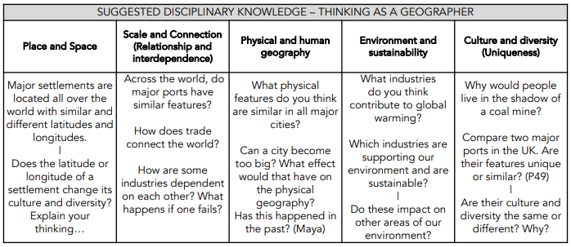


Key Stage 2 – Year 6
Term | NC objectives | The Big Idea Substantive Concepts | How will I think and act like a Geographer | Pupil Outcomes/End Point Knowledge
Year 6 Summer Term Settlements | Human and physical geography - Describe and understand key aspects of human geography, including: - types of settlement and land use, economic activity including trade links, and the distribution of natural resources including energy, food, minerals and water | HUMAN FEATURES – The built environment that was made by humans. PHYSICAL FEATURES – The natural environment and shaped by nature. PLACE – What a place is like and how it is connected to other places. |  | Pupils should know that: - A settlement is a place where humans live. - A pattern in geography is information that can help to explain more about places. These include population patterns, trade route patterns and land use patterns. - All major cities of the world are mostly found on coasts or have navigable rivers for transport and have jobs, opportunities and excellent transport links. - Cities such as Mexico City and Delhi are known as megacities with a population exceeding 15 million. - Trade and transport links can influence where settlements are built. - Should an industry a settlement relies on decline, jobs can be lost and people can move away. - Natural resources are materials that can be exploited to make money. - The pull factors of a city are employment and access to facilities and transport. - The push factors of a city are the cost of living is too high, pollution and congestion. - Migration means many people moving at once. - Immigrants are people who come to live legally and permanently in a foreign country. - The Windrush movement was a geographical pattern - Slavery is when people are forced to move against their will and work for others. An example of this was the Transatlantic slave trade that ran from 1562-1807
Curriculum Narrative and Previous Learning
N 3-4
Year
4
Year
1
Year
5
Key Stage 3

Slide 28
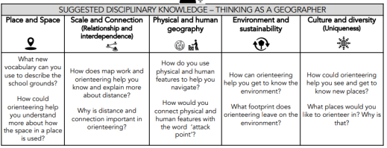

Key Stage 2 – Year 6
Term | NC objectives | The Big Idea Substantive Concepts | How will I think and act like a Geographer | Pupil Outcomes/End Point Knowledge
Year 6 Summer Term Maps and Orienteering | Geographical skills and fieldwork: - use maps, atlases, globes and digital/computer mapping to locate countries and describe features studied - use the eight points of a compass, four and six-figure grid references, symbols and key (including the use of Ordnance Survey maps) to build their knowledge of the United Kingdom and the wider world | GEOGRAPHICAL SKILLS – The use of maps, atlases and globes to know and explain more about location and a place. Use 4 and 6 figure grid references with precision and accuracy. FIELDWORK – Collecting and using information to know more and explain what a location or place is like. Use 4 and 6 figure grid references to explain location and place. |  | Pupils should know that: - Ordnance Survey comes from ‘cannon or great gun’ and ‘look upon or notice’. - Small scale OS maps provide a wider view and are useful for locating cities, towns, motorways, mountains and hails. - Large scale OS maps provide a close-up view, useful for locating houses, buildings, river etc. - A scale of 1:25000, shows 1cm on the map as 250m on the ground. - 4 figure grid references give the location of a 1km x 1km square. They begin with a two letter reference, then have an Eastings number, followed by a Northings number. - 6 figure grid references give a more precise location within a 100m x 100m square. They begin with a two letter reference, followed by a 3-digit Eastings number and a 3-digit Northings number. - 4 figure grid references are useful for general locations e.g. woodlands; 6 figure grid references are useful for locating landmarks, buildings etc. - Orienteering is using a map and compass to navigate around a set course. - Orientating the map means the turn the map to fit the ground. - Orienteering controls are markers that identify a precise location to navigate to. - A red triangle indicates the starting point in orienteering; a red circle indicates a finishing point. - An attack point is a large and obvious feature near a control marker.
Curriculum Narrative and Previous Learning
N 3-4
Year
4
Year
1
Year
5
Key Stage 3

